Slide 1
Credit Crab Approval Prediction

Slide 2
Major Learning
Corelation of categorical variable
Using ANOVA and Chi-Square for feature selection

Slide 3
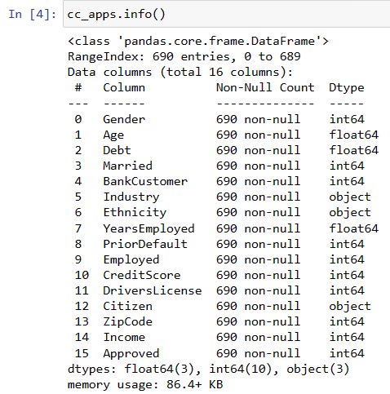
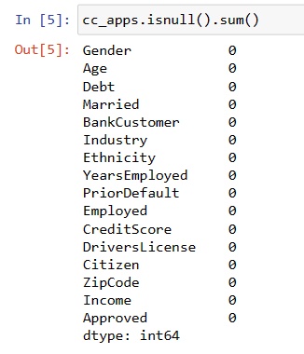
Data Frame

Slide 4
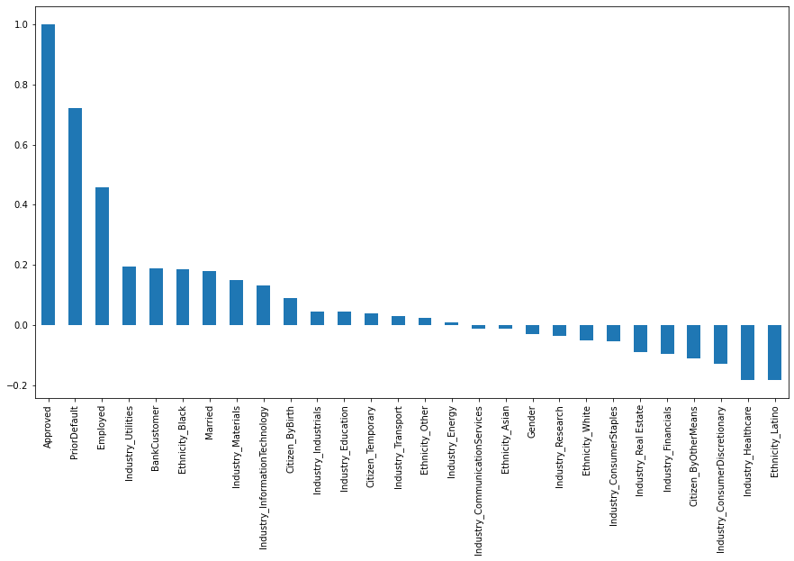

Slide 5
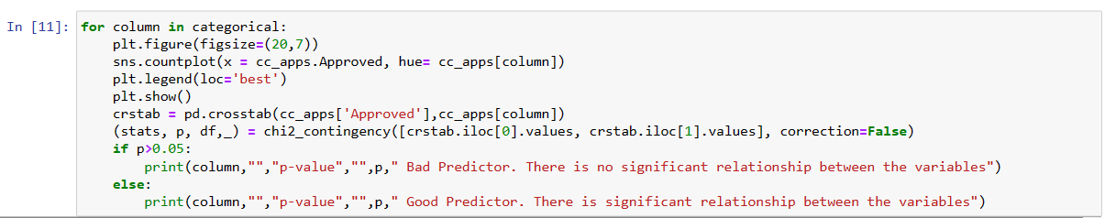

Slide 6
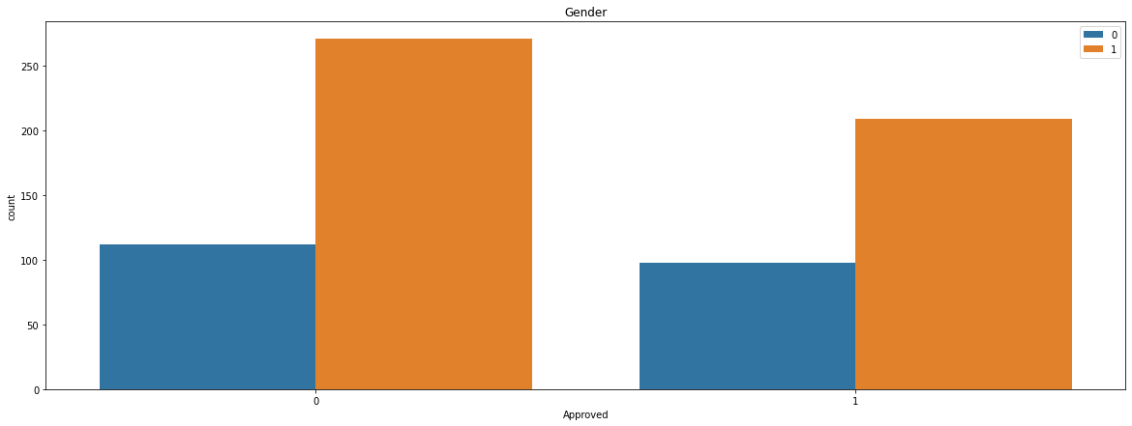
Gender p-value 0.44723087514133186 Bad Predictor. There is no significant relationship between the variables

Slide 7
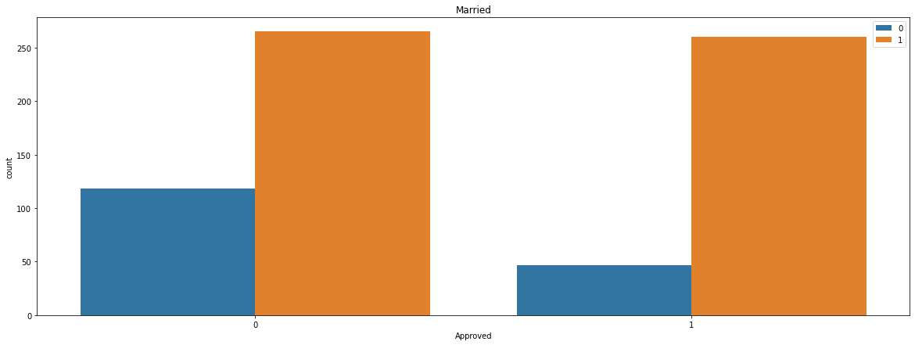
Married p-value 2.100231920165588e-06 Good Predictor. There is significant relationship between the variables

Slide 8
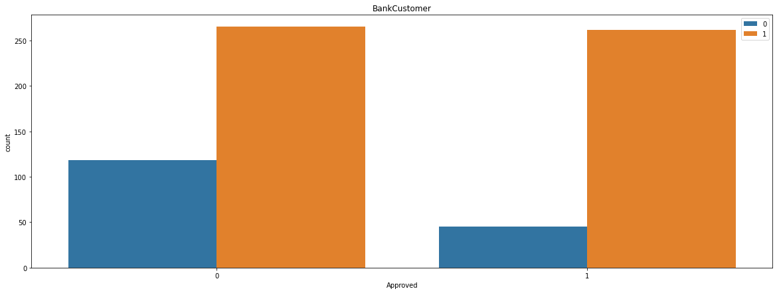
BankCustomer p-value 6.91661320541803e-07 Good Predictor. There is significant relationship between the variables

Slide 9
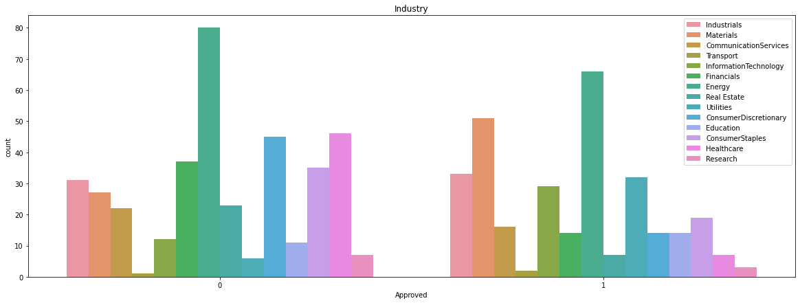
Industry p-value 3.502987066102042e-15 Good Predictor. There is significant relationship between the variables

Slide 10
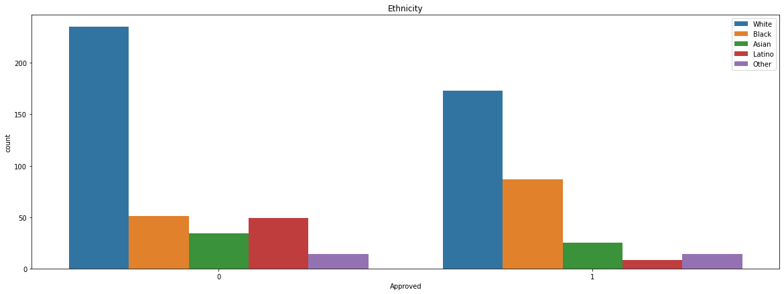
Ethnicity p-value 1.823665654934685e-08 Good Predictor. There is significant relationship between the variables

Slide 11
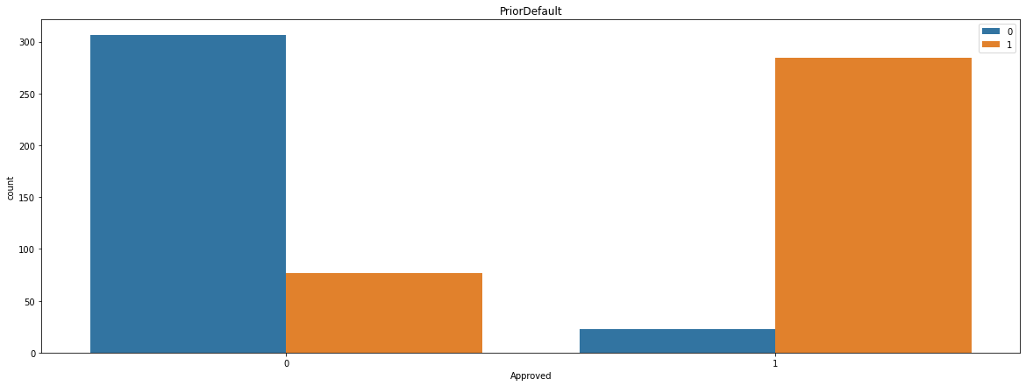
PriorDefault p-value 7.298530125411298e-80 Good Predictor. There is significant relationship between the variables

Slide 12
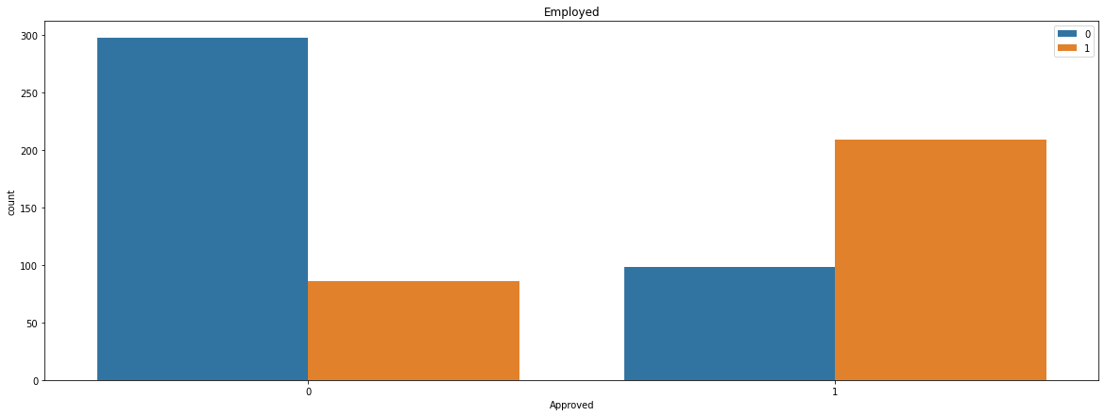
Employed p-value 2.227269345312281e-33 Good Predictor. There is significant relationship between the variables

Slide 13
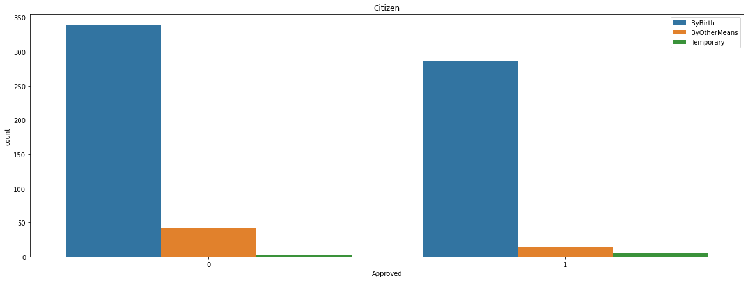
Citizen p-value 0.010094291370456362 Good Predictor. There is significant relationship between the variables

Slide 14
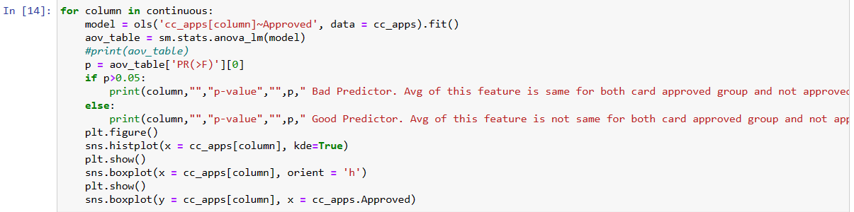

Slide 15
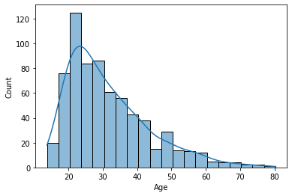
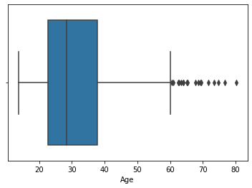
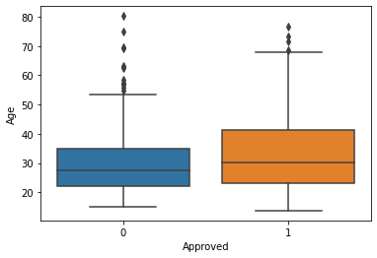
Age p-value 1.479154858352859e-05 Good Predictor. Avg of this feature is not same for both card approved group and not approved group

Slide 16
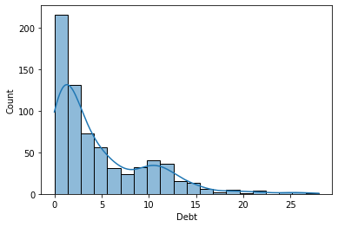
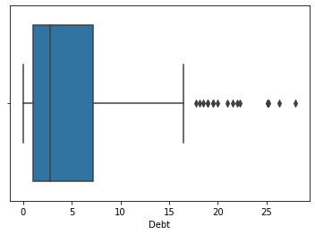
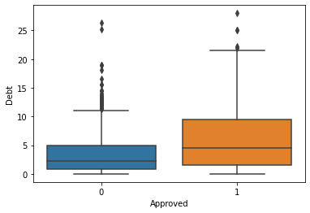
Debt p-value 4.5516807023089123e-08 Good Predictor. Avg of this feature is not same for both card approved group and not approved group

Slide 17
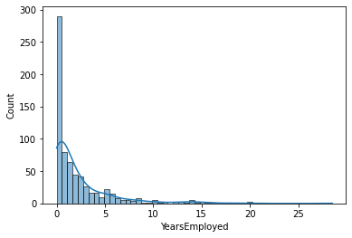
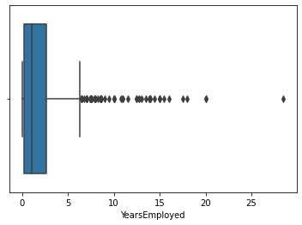
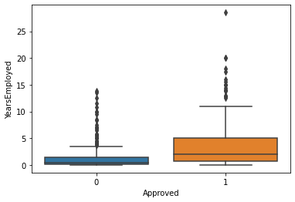
YearsEmployed p-value 3.6710537401606784e-18 Good Predictor. Avg of this feature is not same for both card approved group and not approved group

Slide 18
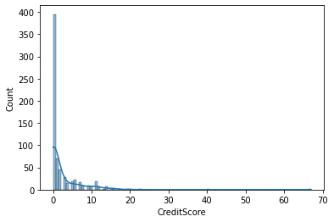
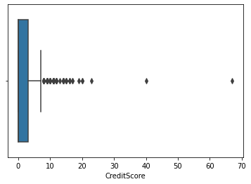
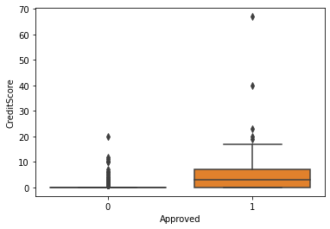
CreditScore p-value 7.957718568080603e-29 Good Predictor. Avg of this feature is not same for both card approved group and not approved group

Slide 19
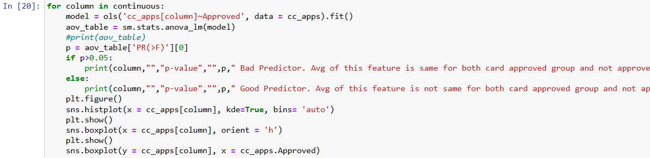

Slide 20
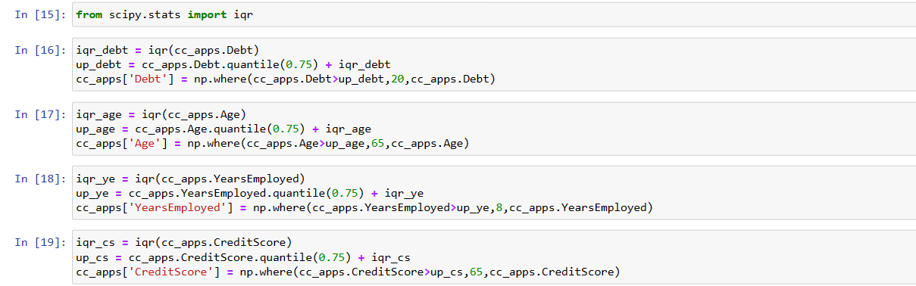

Slide 21
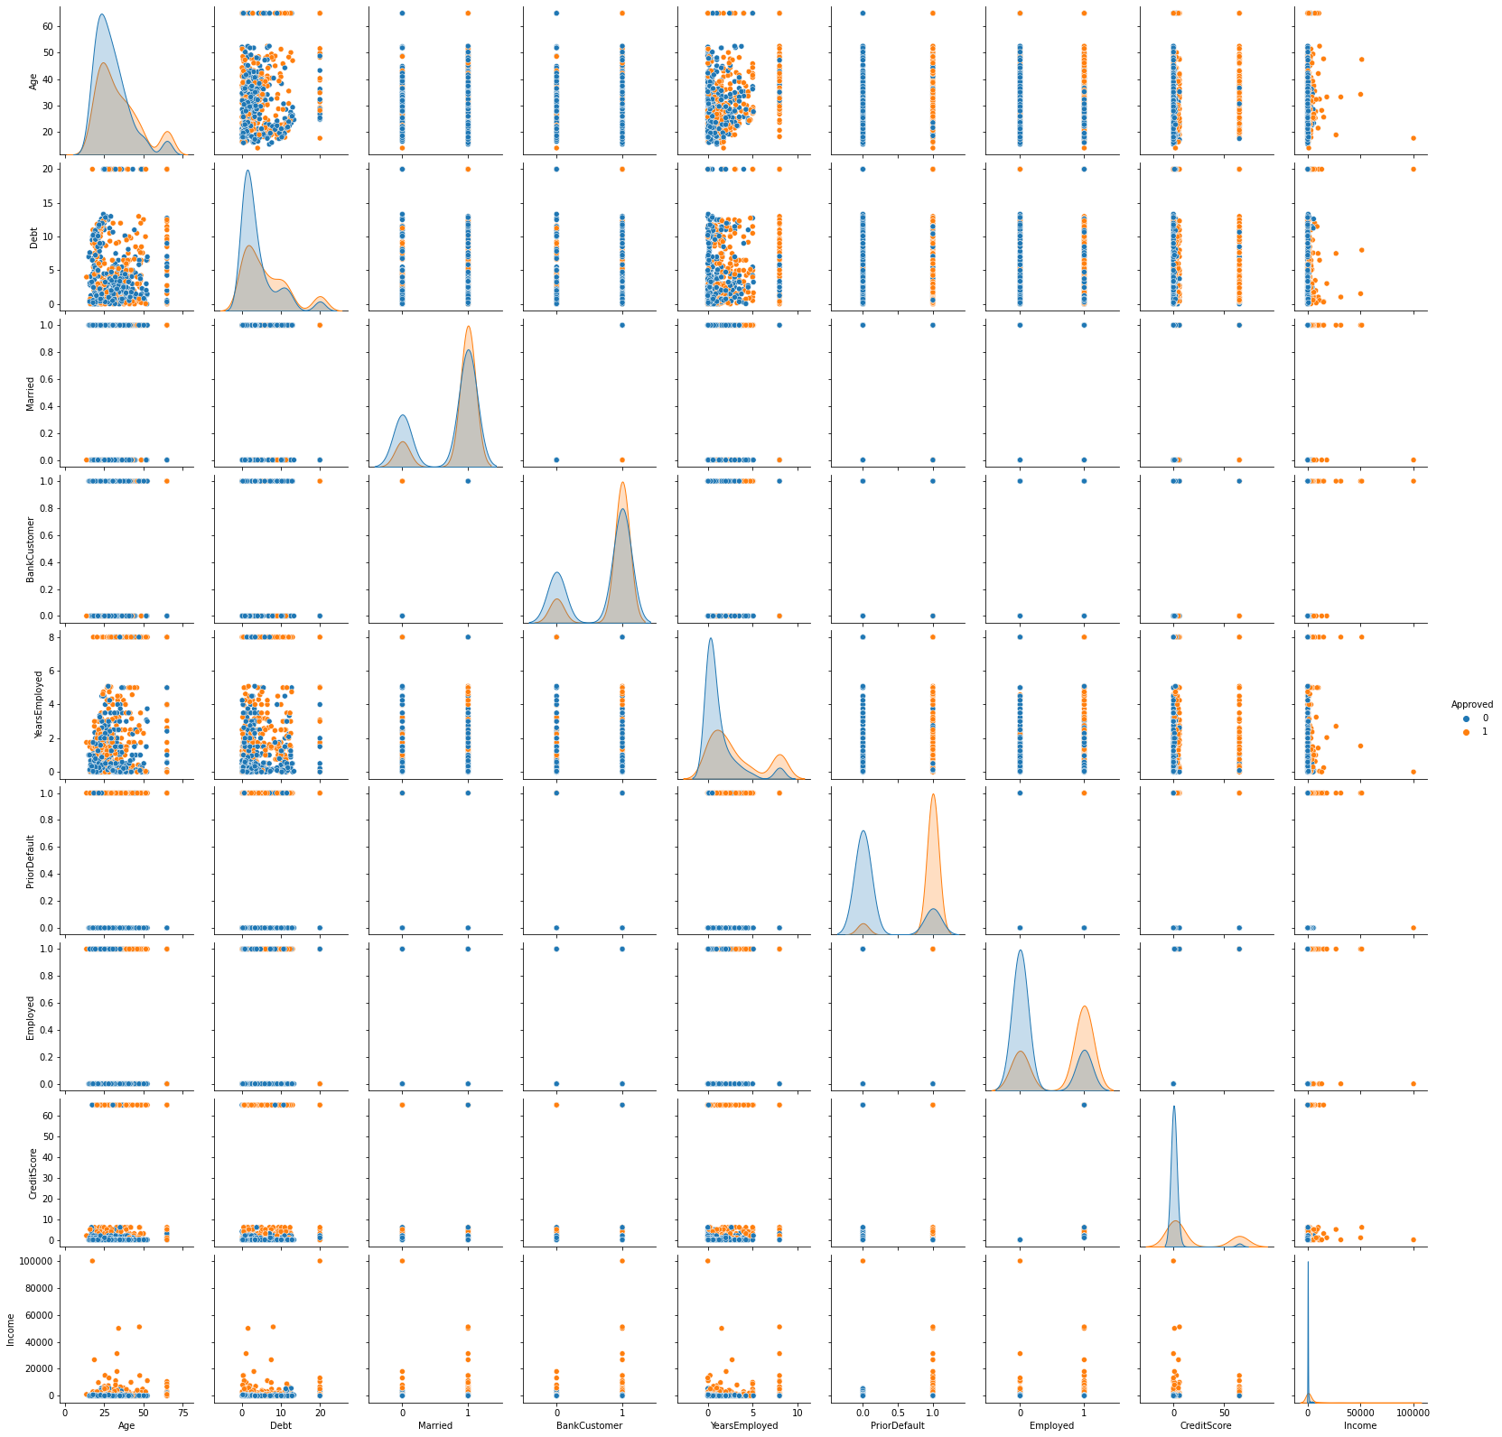
Data is not linearly separable

Slide 22
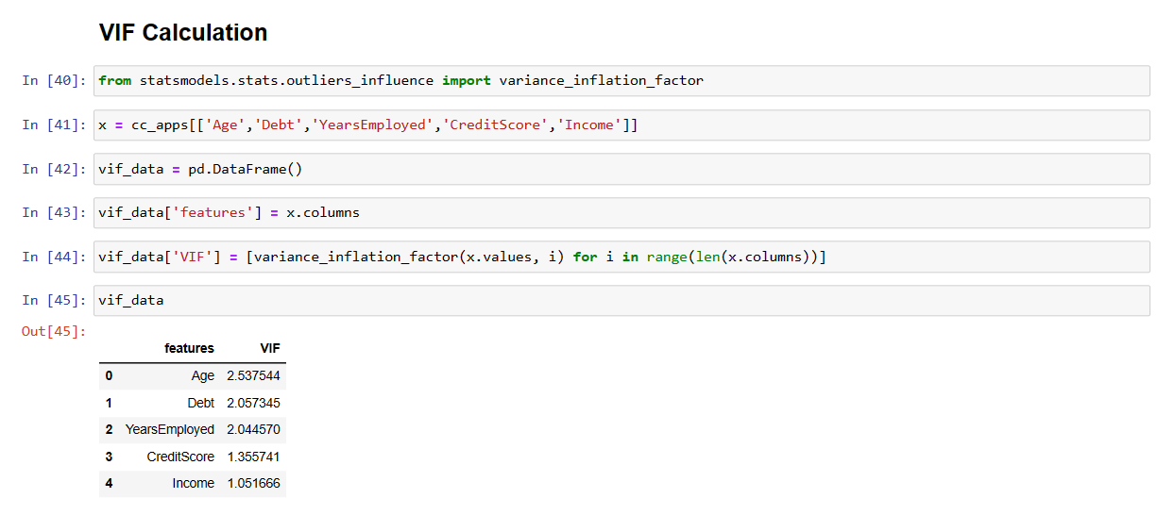

Slide 23
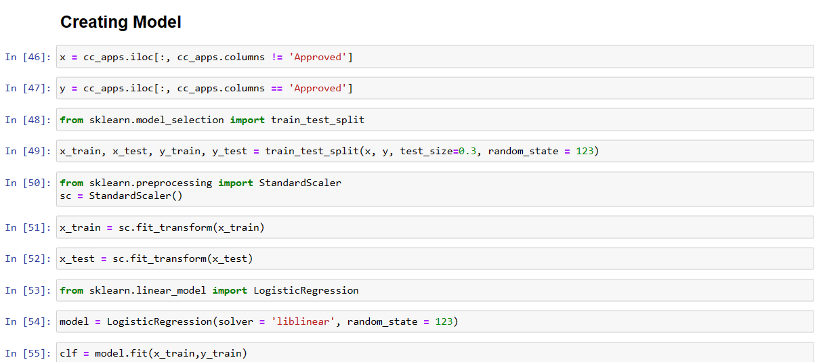
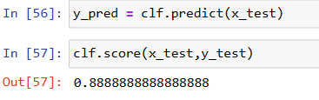

Slide 24
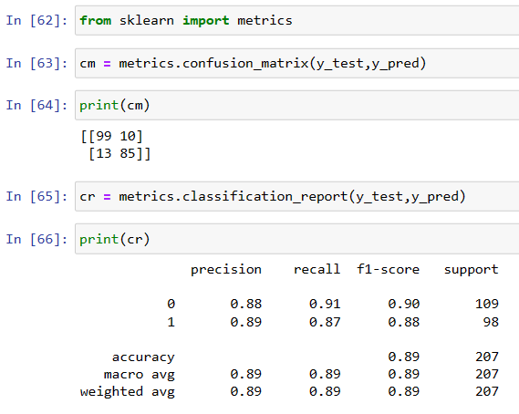
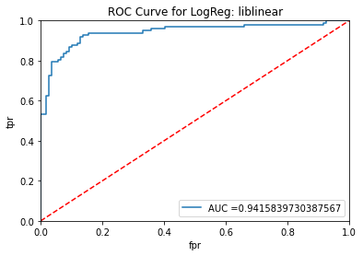

Slide 25
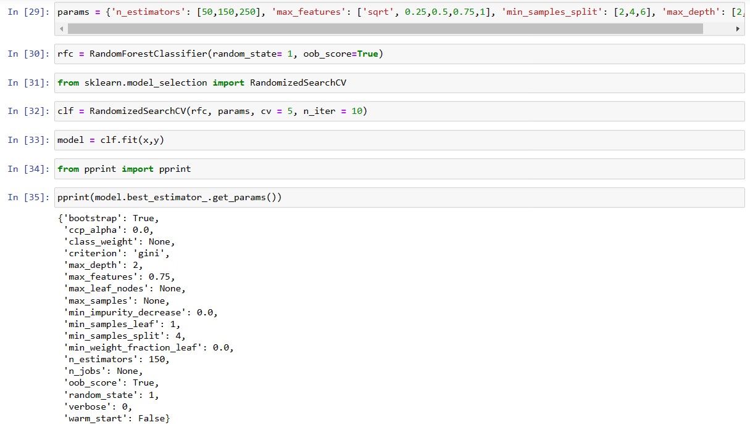

Slide 26
